Slide 1

AI304 PATTERN RECOGNITION PROJECT
Automated Face Recognition using DWT, PCA, and Machine Learning
Presented by: Manus AI
Date: May 10, 2026

Slide 2

INTRODUCTION & PROBLEM STATEMENT
PATTERN RECOGNITION
THE PROBLEM
Definition
Face Recognition Challenges
Enabling computers to identify patterns, classify data,
Accurately identifying individuals despite variations in
and make intelligent decisions based on observations.
expression, lighting, and head pose.
Applications
Project Motivation
Computer Vision, Medical Diagnosis, Biometrics, and
Critical for modern security and human-computer
Autonomous Systems.
interaction. Building a robust pipeline is essential.
> Core field of Artificial Intelligence
> Goal: Design an applied recognition system

Slide 3

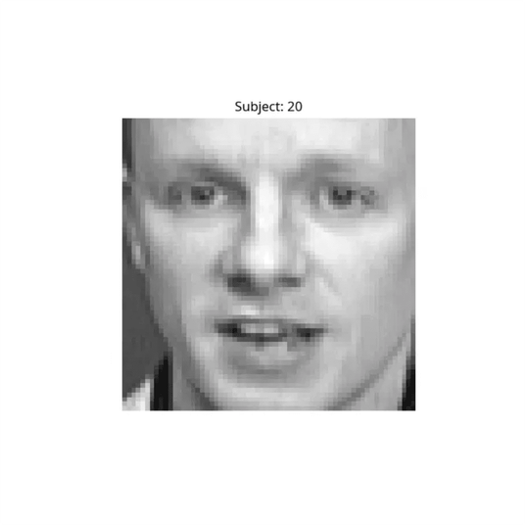
DATASET: AT&T DATABASE OF FACES
400
40
TOTAL IMAGES
DISTINCT SUBJECTS
Resolution: 64x64 grayscale pixels per image.
Variations: Captured variations in facial expression, lighting conditions, and head pose (up to 20 degrees).
Preprocessing: Images are standardized and normalized for consistency across the recognition pipeline.
Sample from Olivetti Dataset

Slide 4

PATTERN RECOGNITION PIPELINE
01
02
03
04
05
ACQUISITION
FEATURE EXTRACTION
DIM. REDUCTION
CLASSIFICATION
EVALUATION
Loading the Olivetti Research Laboratory dataset.
Decomposing images into frequency sub-bands.
Projecting data onto principal components.
Training multiple ML models for recognition.
Assessing performance with standard metrics.
2D DWT (HAAR)
PCA (95% VAR)
SVM | KNN | RF
F1 | ACCURACY
SKLEARN DATA

Slide 5

FEATURE EXTRACTION: DISCRETE WAVELET TRANSFORM
THE METHOD
THE OUTPUT
Purpose
Feature Selection
Decompose facial images into multi-resolution
Extracted the
LL sub-band
(Approximation
frequency components to isolate significant
Coefficients) which contains the low-frequency
features.
structural data.
Implementation
Key Benefit
Applied a single-level 2D DWT using the Haar
Retains essential facial geometry while effectively
wavelet.
Wavelet: 'db1' (Haar)
filtering out high-frequency noise and minor
variations.
Output: Flattened 1D Vectors

Slide 6

DIMENSIONALITY REDUCTION: PCA
THE CONCEPT
TECHNICAL IMPLEMENTATION
Principal Component Analysis
Variance Preservation
A statistical procedure that uses an orthogonal
Configured to retain components explaining 95% of
transformation to convert correlated variables into
the total variance, ensuring minimal information loss.
linearly uncorrelated principal components.
95% Variance
Feature Compression
Threshold for Component Selection
Applied to DWT features to reduce the feature space
while retaining the most significant information.
Eigenfaces
The resulting principal components represent the
most prominent facial features across the dataset.

Slide 7

CLASSIFICATION MODELS
SVM (RBF)
KNN (K=3)
RANDOM FOREST
A powerful classifier that finds the optimal hyperplane in high-dimensional space. Effective for complex decision boundaries.
A simple, instance-based learning algorithm that classifies based on the majority class of its nearest neighbors.
An ensemble method using multiple decision trees to improve accuracy and control over-fitting.
CONFIGURATION
CONFIGURATION
CONFIGURATION
Estimators: 100
Kernel: RBF
Neighbors: 3
Criterion: Gini
C: 10
Metric: Euclidean
Max Features: Sqrt
Gamma: 0.001
Weights: Uniform

Slide 8

MODEL COMPARISON METRICS
MODEL
ACCURACY
PRECISION
RECALL
F1-SCORE
SVM (RBF)
0.9500
0.9667
0.9500
0.9467
KNN (k=3)
0.8125
0.8083
0.8125
0.7842
Random Forest
0.9500
0.9708
0.9500
0.9483

Slide 9

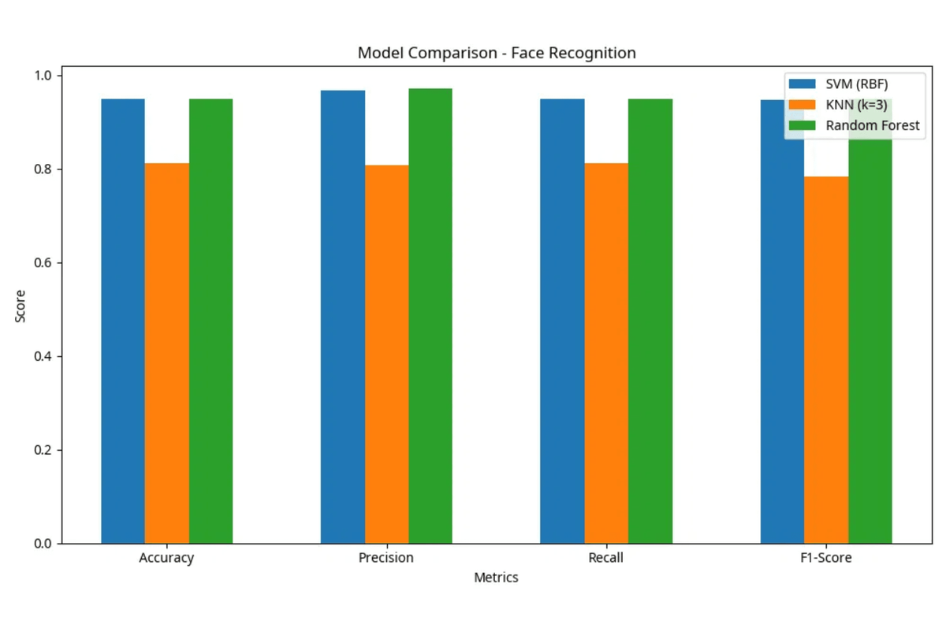
VISUALIZATIONS: MODEL COMPARISON
KEY INSIGHTS
> PERFORMANCE PARITY
Both SVM and Random Forest achieved a
peak accuracy of 95%, demonstrating high
robustness in the feature space.
> KNN LIMITATIONS
KNN lagged at 81.25%, likely due to the high-
dimensional nature of facial data even after
PCA reduction.
> PIPELINE SUCCESS
The combination of DWT and PCA provided a
highly discriminative feature set for the top-
tier classifiers.

Slide 10

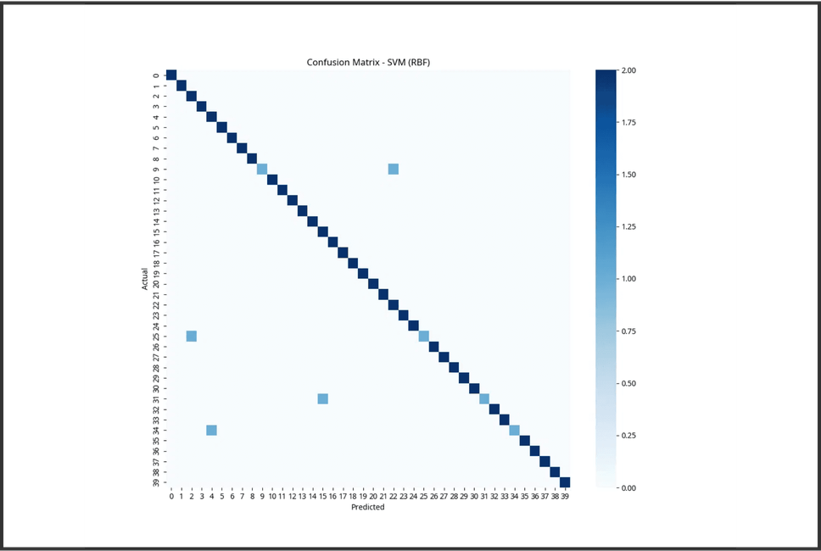
VISUALIZATIONS: CONFUSION MATRIX
ANALYSIS
Diagonal Density
The strong diagonal line confirms that the majority of test samples were correctly classified for all 40 subjects.
Error Distribution
Minimal off-diagonal points indicate very low misclassification rates between different individuals.
Model: Random Forest Classifier
Robustness
The model demonstrates high reliability despite variations in facial expressions and lighting.

Slide 11

CONCLUSION & FUTURE IMPROVEMENTS
KEY FINDINGS
FUTURE WORK
Pipeline Success
Advanced Architectures
Successfully implemented a complete Pattern
Explore Deep Learning models (CNNs) and more complex
Recognition pipeline using DWT for feature extraction
wavelet families for improved feature representation.
and PCA for dimensionality reduction.
Optimization & Scale
Model Performance
Implement automated hyperparameter tuning and
SVM and Random Forest achieved a high accuracy of
evaluate performance on larger, more diverse datasets
95%, significantly outperforming KNN (81.25%).
like LFW.
> All technical requirements fulfilled.
> Target: Real-time robust recognition.

Slide 12

Q&A
THANK YOU FOR YOUR ATTENTION!
Questions?

